Slide 1
R Clinic
Session 9:
Introduction to Spatial Statistics

Slide 2
REMINDER: write down your email address for access to the Dropbox with slides and code.
We will be in this room until beginning of August

Slide 3
Spatial statistics
Variety of analytical techniques to study the topology, geometry and geography of entities
Not always on a map!
Many different R packages for spatial analysis
Lots of different techniques

Slide 4
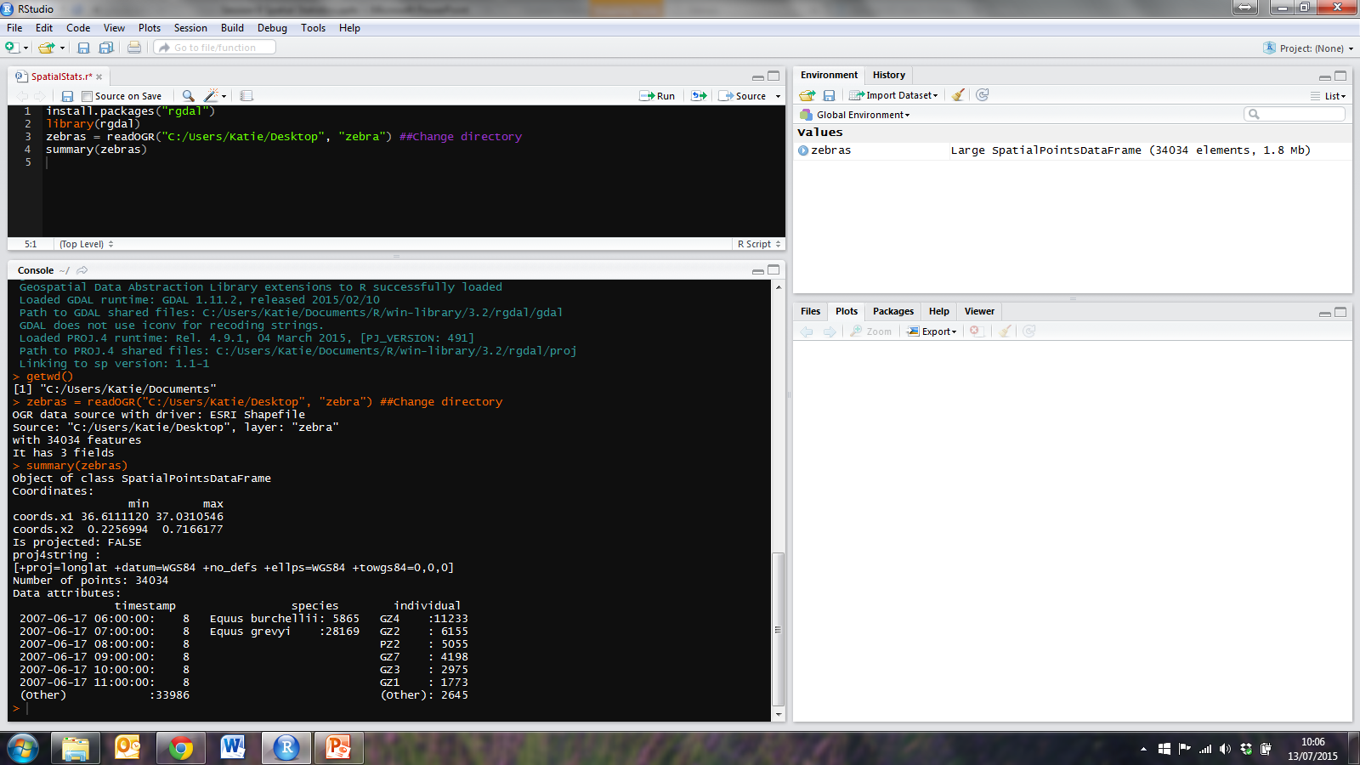
Zebra dataset
Animal tracking data from MoveBank
Read in using rgdal package
Summary of data

Slide 5
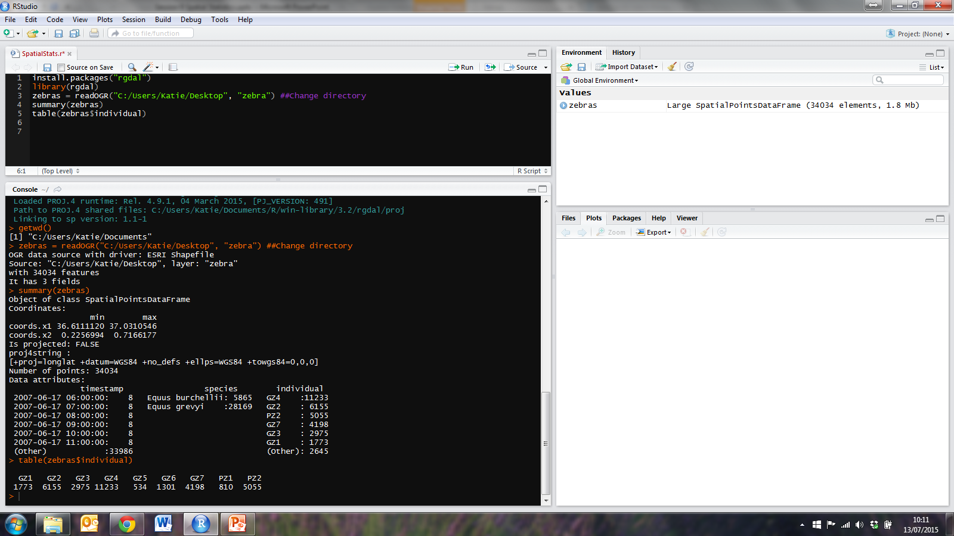
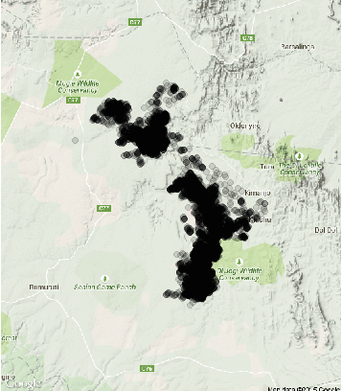
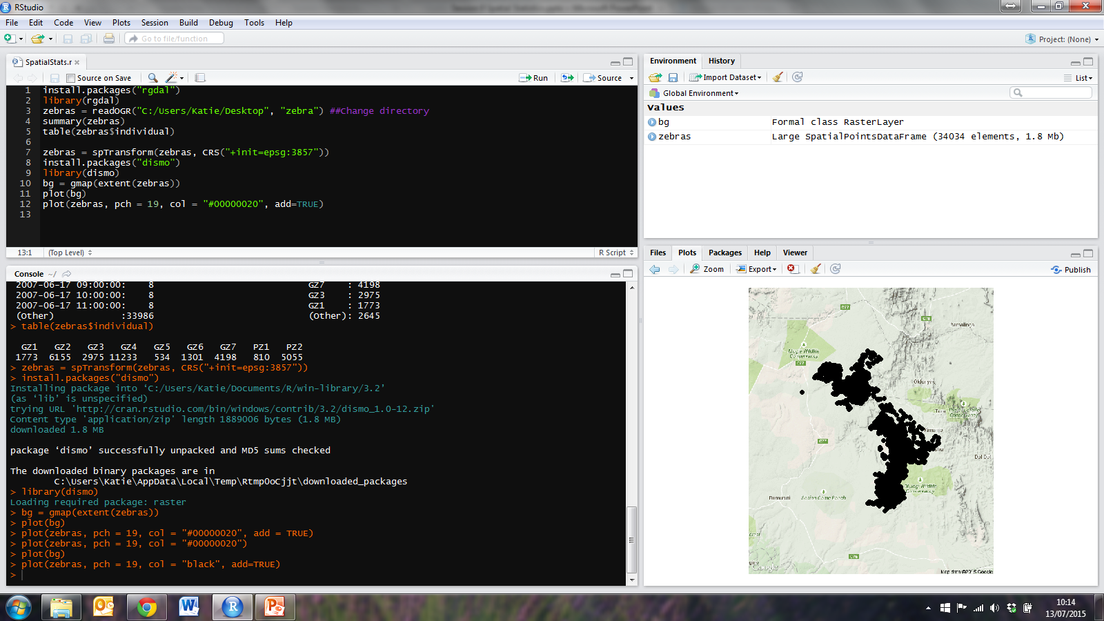
Zebra dataset
Use table() to show there are records for two species and 9 individuals
Plot on Google Maps
NB. Change of coordinate system
using spTransform()

Slide 6
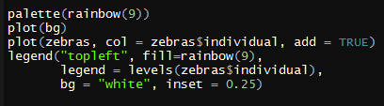
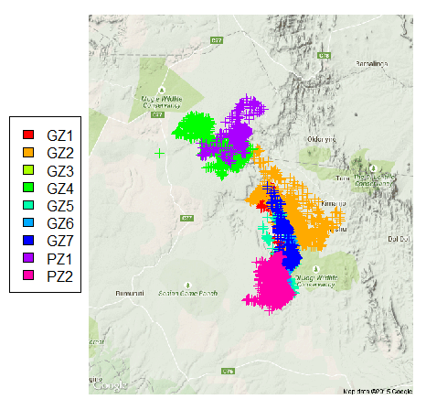
Zebra dataset
Plot different coloured points for different individuals
Can also try plotting by
species

Slide 7
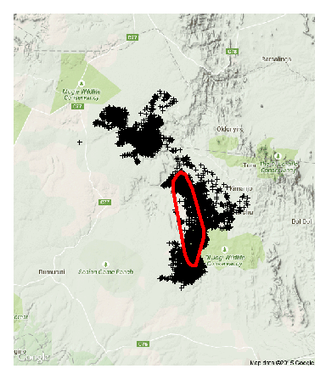
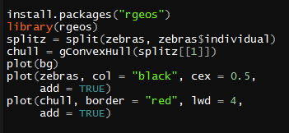
Zebra dataset
Plot convex hull for individual 1’s range
NB. Uses function
gConvexHull()

Slide 8
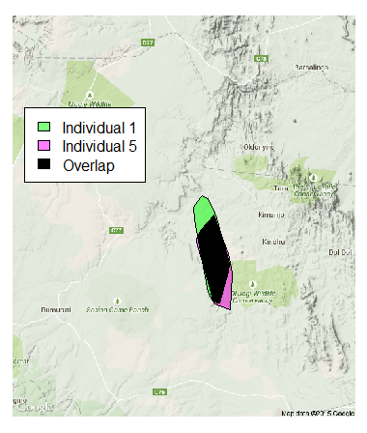
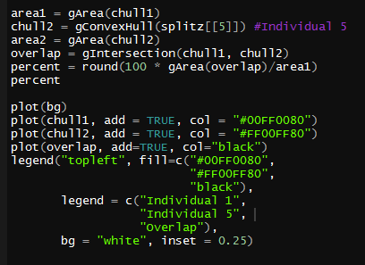
Zebra dataset
Calculate area and intersection of convex hull

Slide 9
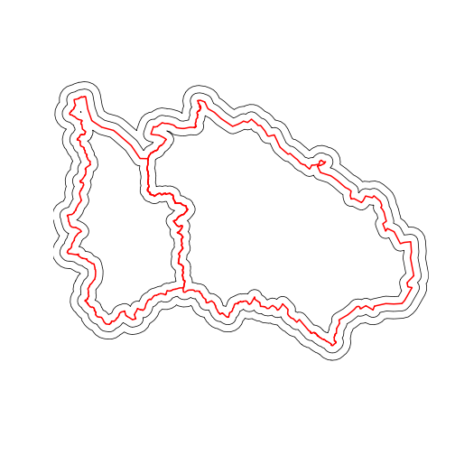
Other useful functions in rgeos
gUnaryUnion()
gBuffer()
gDistance()
And many more!

Slide 10
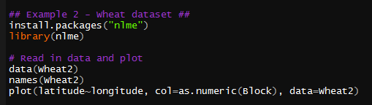
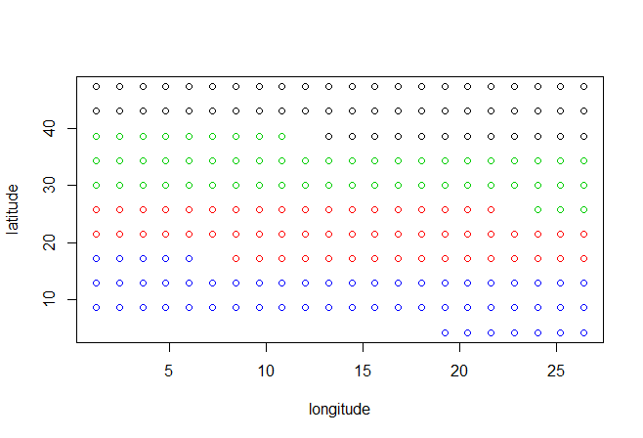
Wheat dataset
“Agronomic wheat trial in which the yields of 56 varieties of wheat were compared. The trials were arranged in four geographic blocks in which each variety was planted once.”

Slide 11
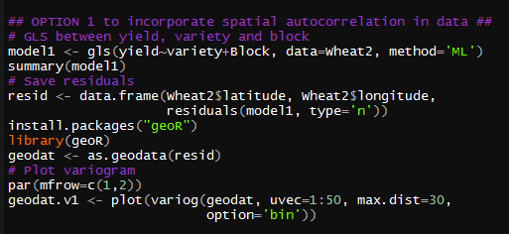
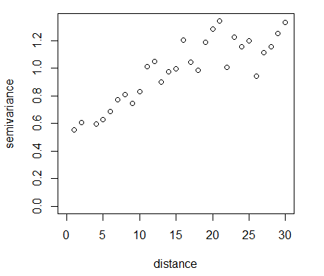
Wheat dataset
Option 1 to account for spatial autocorrelation in model – using geoR package
gls()
NB. “method=‘ML’”
Type=‘n’ – normalised residuals

Slide 12
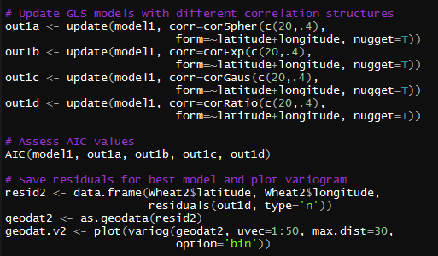
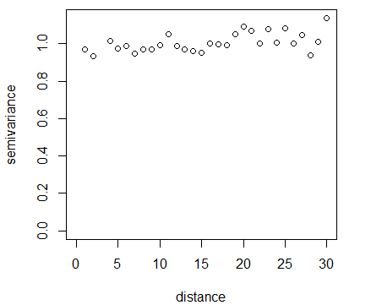
Wheat dataset
Update gls models with different correlation structures then compare AIC values

Slide 13
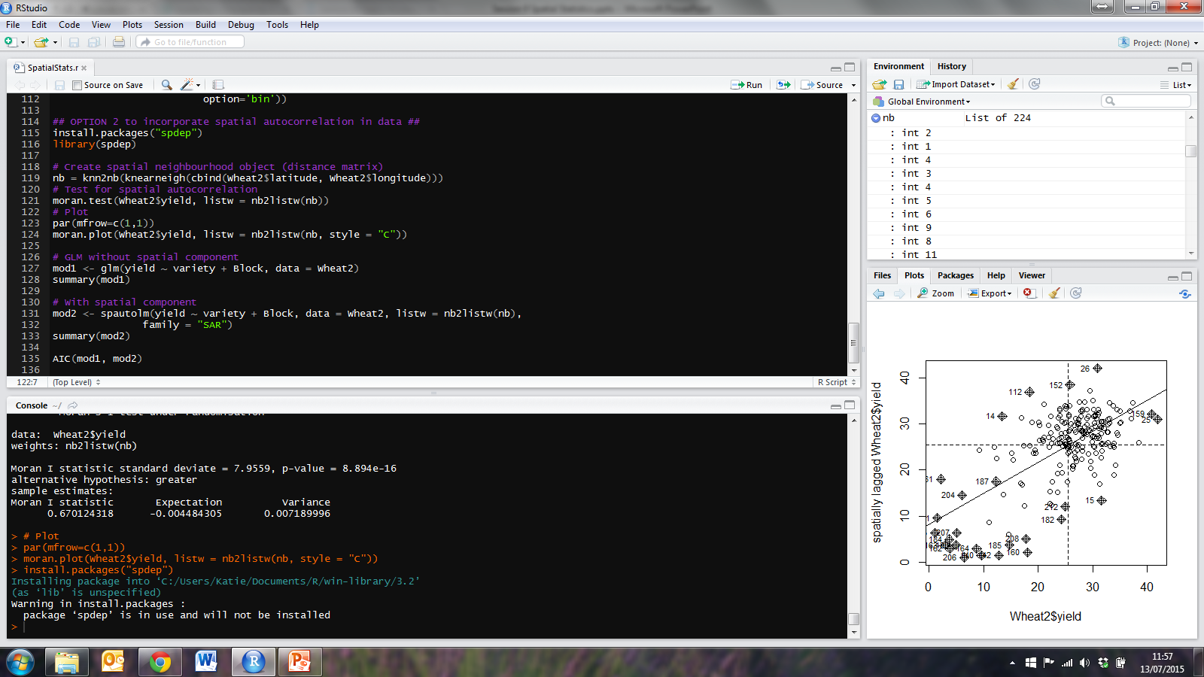
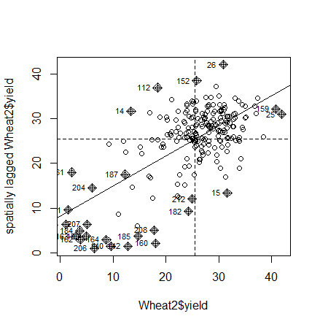
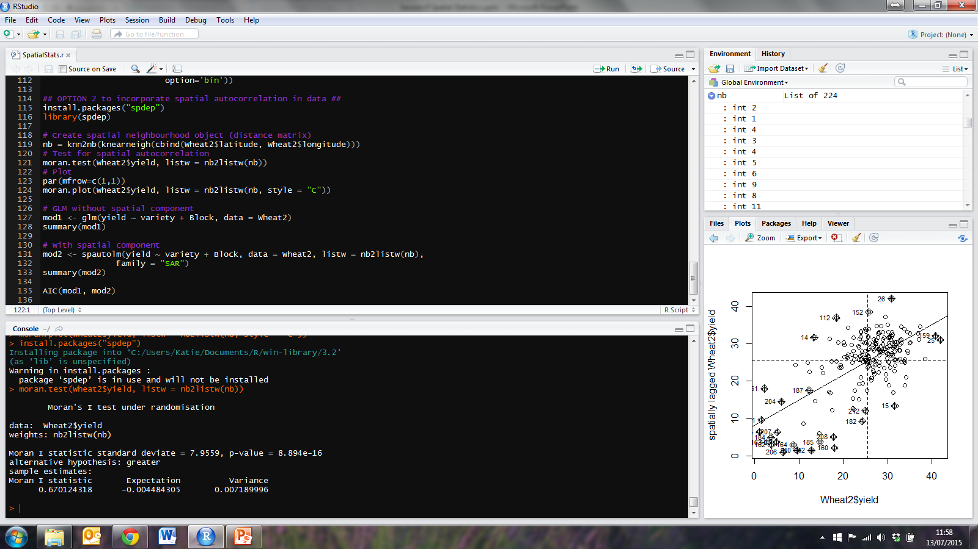
Wheat dataset
Option 2 to account for spatial autocorrelation in model – using spdep package

Slide 14
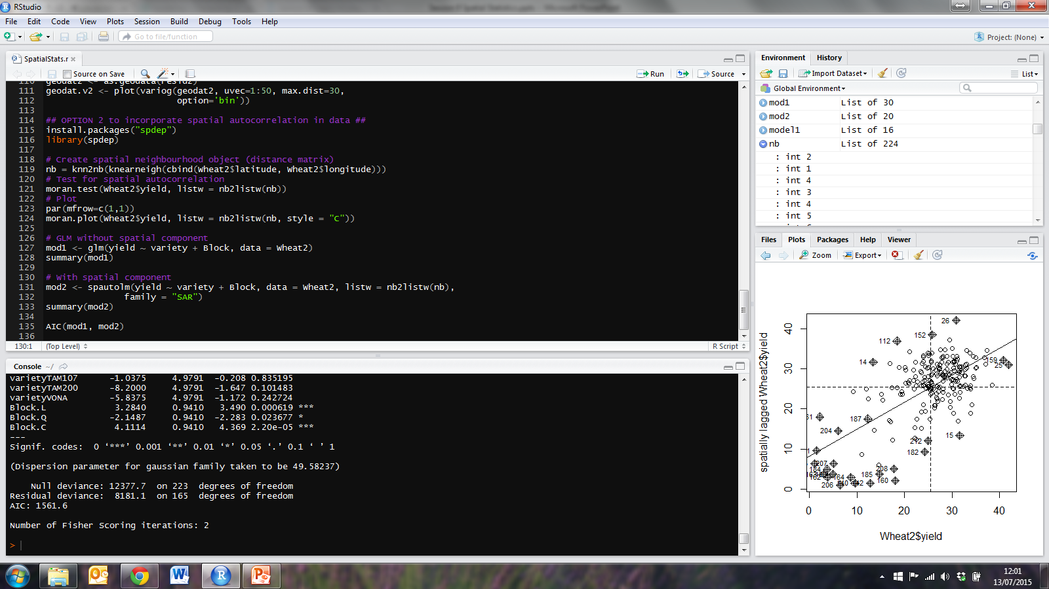
Wheat dataset
Option 2 to account for spatial autocorrelation in model – using spdep package
glm() without spatial component
spautolm() with spatial component
Compare AIC values

Slide 15
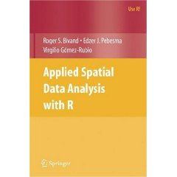

Cheat sheet for Spatial Data
http://www.maths.lancs.ac.uk/~rowlings/Teaching/Sheffield2013/cheatsheet.html
Also see:

Slide 16
Summary
rgdal package to read in shapefiles
Can use raster package for rasters and sp package for other data types
rgeos package to explore spatial data
nlme package for gls() and update of correlation structure
spdep package for moran.test() and spautolm()
others include spatial, sp, SpatialPack (e.g. for modified.ttest), spatstat, CARBayes

Slide 17
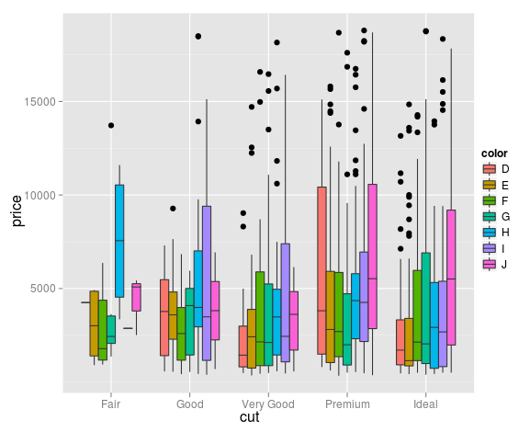
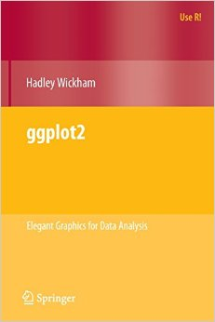
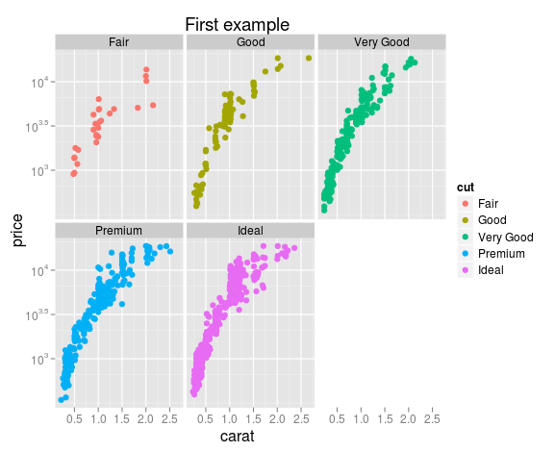
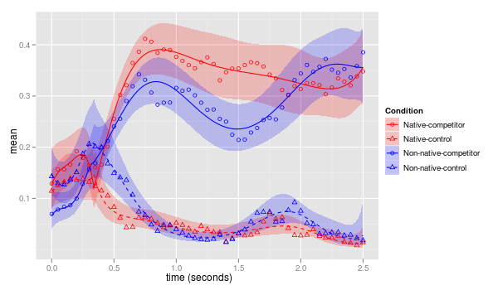
Next week
Further Data Visualisation!

